Slide 1
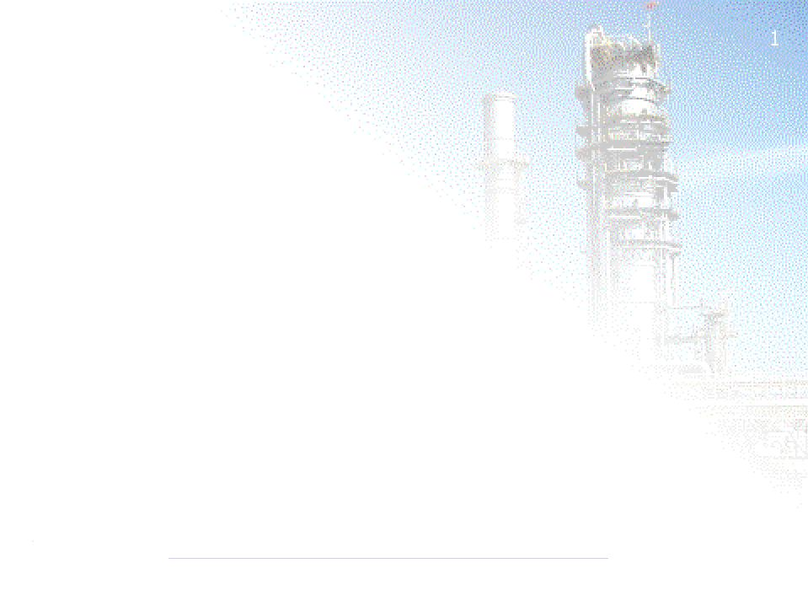
Introduction to Petroleum Refining
4th September 2003
Engineering Faculty
UKM, Bangi
Presented by:
M Radzif A Kader
Process Engineer
Petronas Penapisan (M) Sdn Bhd

Slide 2
The Visiting Presenter
Graduated with a BEng (Hons) Chemical Engineering from University of Manchester Institute of Science and Technology (UMIST) in 1999
Joined Petronas Penapisan Melaka Sdn Bhd (PPMSB) in Sungai Udang in November 1999
Served as a Process Engineer (Technology Dept.) at the Crude Distillation Unit (PSR-1) for 3 1/2 Years and worked on :
  Improvement Projects
  Plant Monitoring and Troubleshooting
  Turnaround Activities (2002)
Currently attached to the Six Sigma Department handling Plant Improvement Projects

Slide 3
Objectives
This Session will assist you to Understand:
1. The Petroleum Refining Process
2. The Sulphur Recovery Process
3. Which products are produced at certain Qualities
4. Health, Safety and Environment (HSE) in the Refinery
5. Simple Economics of a Refinery

Slide 4
Topics
1. Overview of PPMSB
2. The Petroleum Refining Process
3. Sulphur Recovery
4. Product Specifications and Quality Control
5. Health, Safety and Environment (HSE)
6. Simple Economics of a Refinery

Slide 5
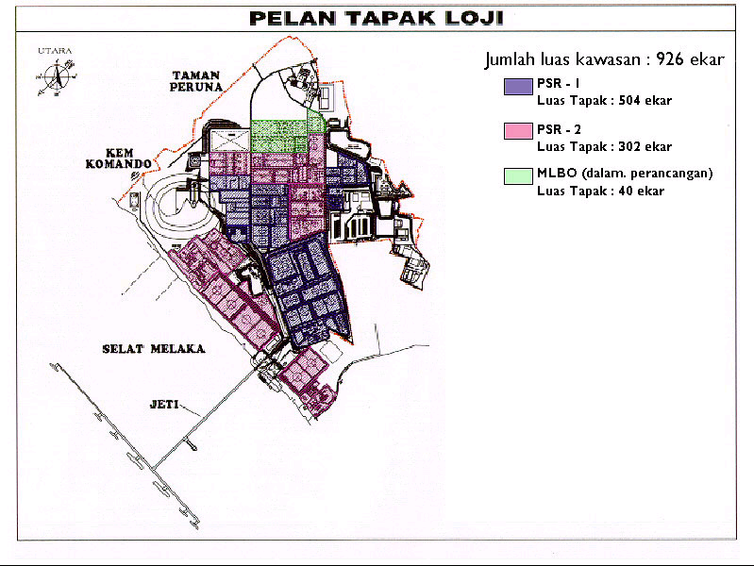
Overview of PPMSB

Slide 6
p
Petroliam Nasional Berhad (PETRONAS)
Incorporated on 17th August 1974
Diversified and fully integrated business covering
  Exploration & Production
  Refining
  Gas Processing
  Trading & Marketing Petroleum Products
  Petrochemical Industry
Currently owns
  121 Subsidiaries and Affiliated Companies
    81 Local
    40 International

Slide 7



PPMSB & MRC
Incorporated on 19th September 1989
Wholly owned by Petronas
Manage and Operate the Refinery Complex in Melaka
Incorporated on 3rd May 1991
Ownership
  Petronas 53 %
  Conoco-Philips 47 %

Slide 8
Vision
“A World Class Integrated Hydrocarbon Processing Centre of Choice “
Mission
To commission , operate, maintain, and safeguard
PSR-1 and PSR-2 and their common and joint
facilities
To implement Expansion & Upgrading of the
above or other facilities

Slide 9
PSR means Petronas Second Refinery
  1st refinery : PPTSB in Kerteh, Terengganu.
  3rd refinery : Engen in South Africa
Petronas Penapisan(Melaka) Sdn Bhd consists of :
  PSR-1 @ Petronas Second Refinery Phase 1(wholly owned by Petronas)
    100,000 BPSD design capacity processing local sweet feedstock(Sulfur < 0.5wt%)
    Hydroskimming configuration(Sweet train)
  PSR-2 @ Petronas Second Refinery Phase 2(owned by MRC ie Petronas 53% & Conoco 47%)
    100,000 BPSD design capacity processing up to 70% sour feedstock(Sulfur > 2.5wt%) mainly middle east crudes
    Complex conversion configuration(Sour Train)

Slide 10
